Slide 1
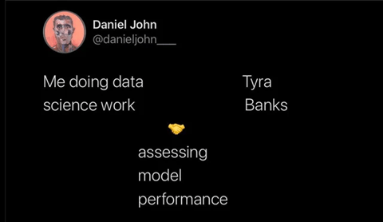
Topic 5 – (Over)Fitting and Evaluating Models
Data Science for Business
Prof: Chris Volinsky
NYU Stern: Spring 2025

Slide 2
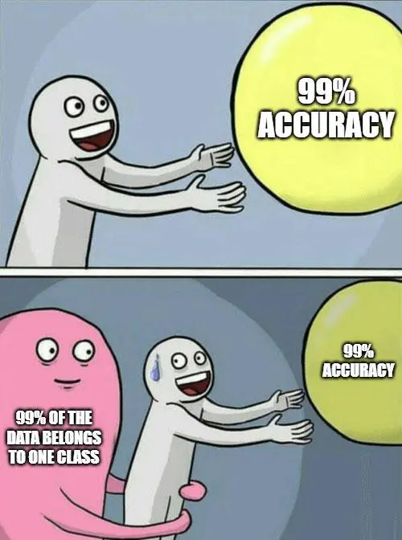
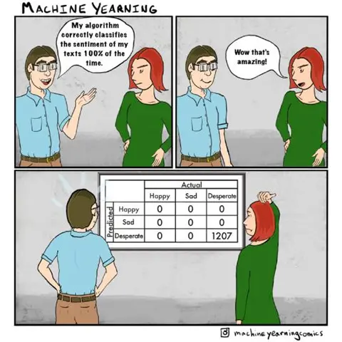

Slide 3
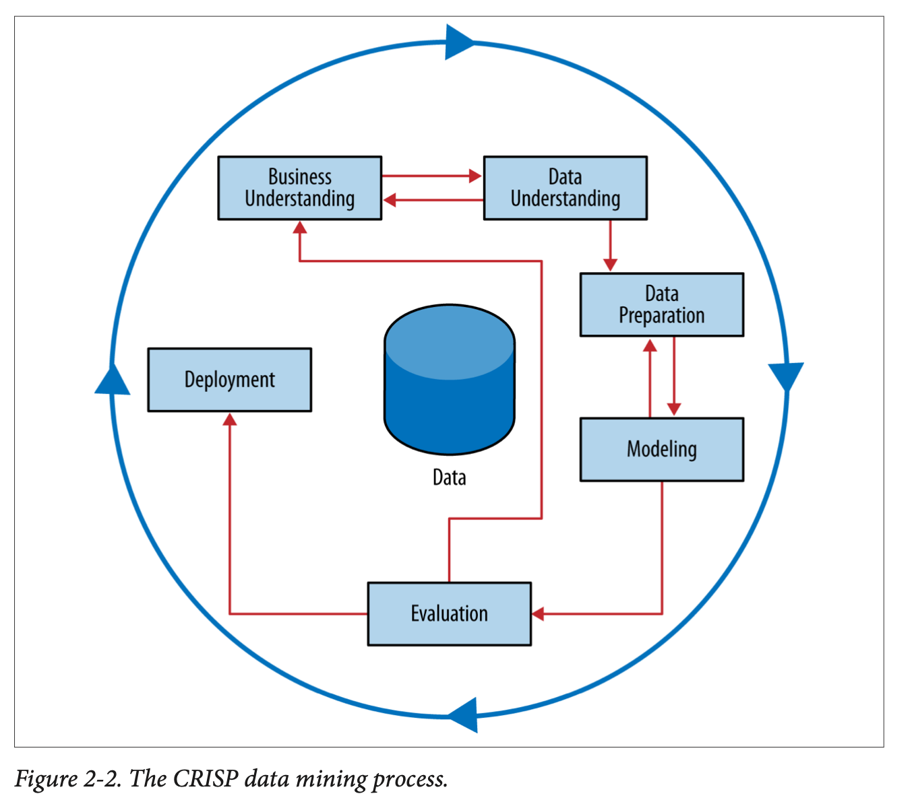

Slide 4
Evaluating models
If we apply accuracy to trees built on the training set …
the biggest tree will always be best!
In fact, you can often build a tree with 100% accuracy on the training set
But, our goal is to generalize to data we have not seen yet

Slide 5
Evaluating models
How do we protect against this? Training / test data
Original data
Training Data
(80%?)
Test (holdout) data
(20%?)
Splitting the data this way serves two purposes:
Provides a better estimate of model performance in the“real world”
And
Optimizes the value of model parameters (e.g. tree_depth)
From sklearn.model_selection import train_test_split

Slide 6
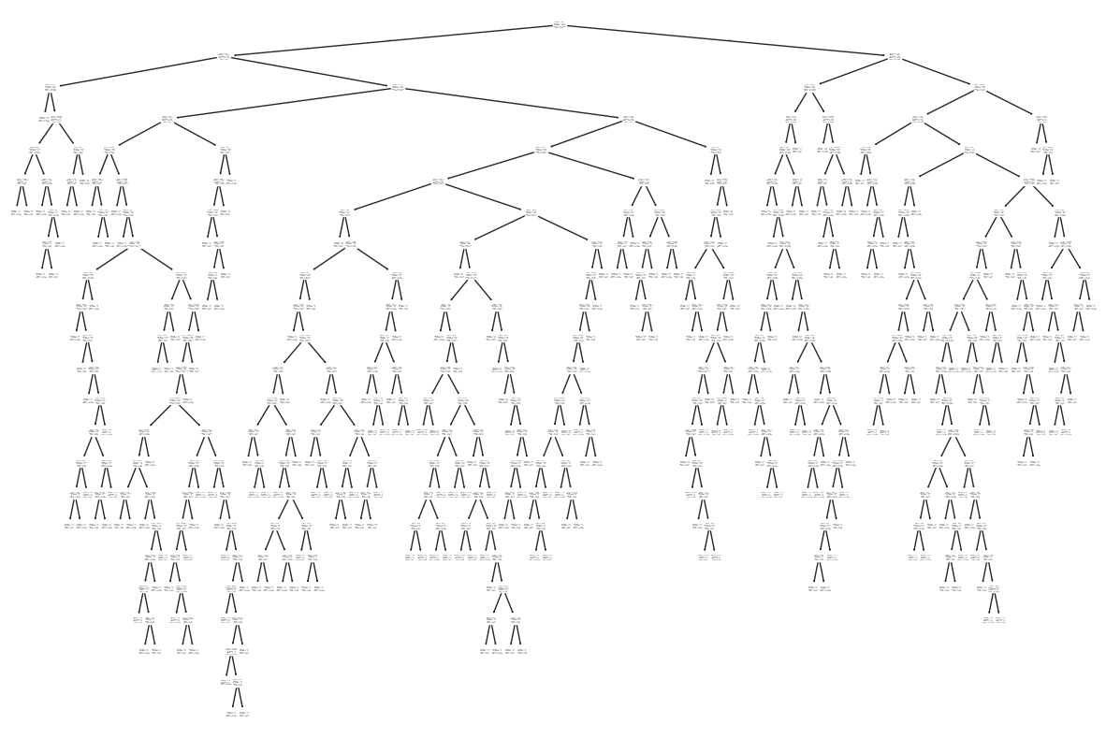
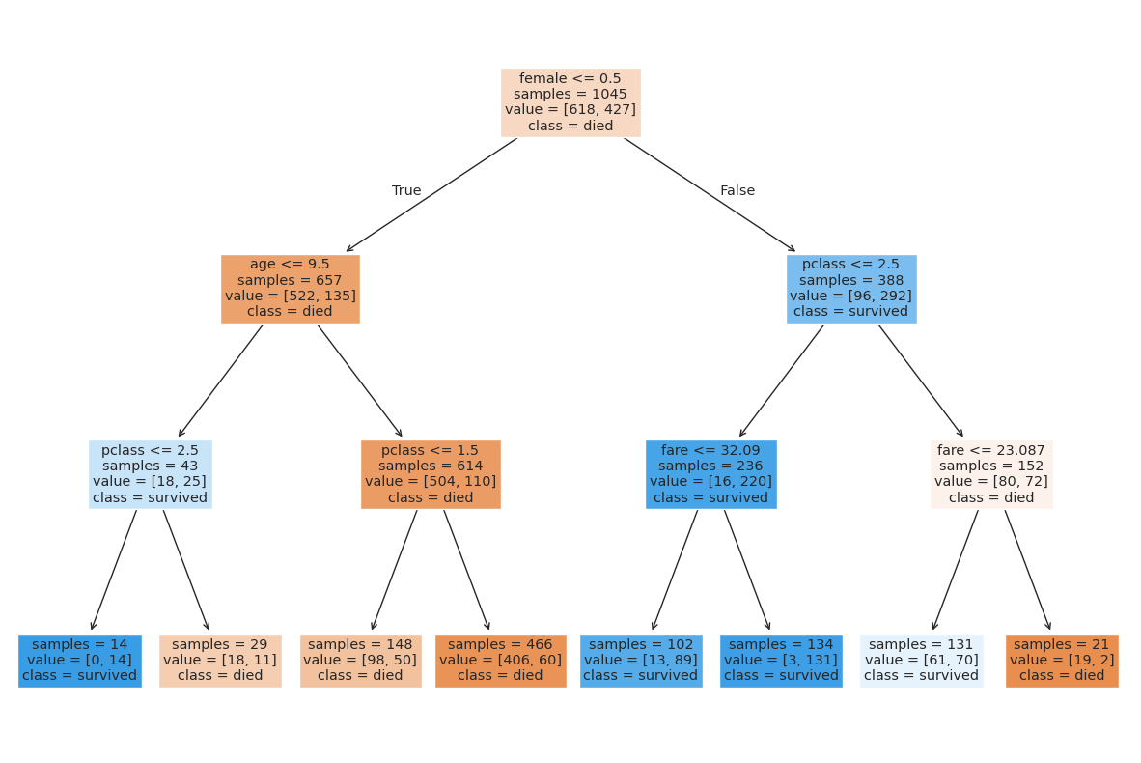
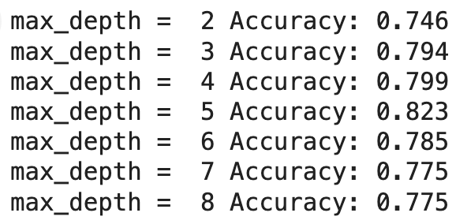
Evaluation and model complexity
We typically have to scale back on complexity in order to improve generalization error

Slide 7

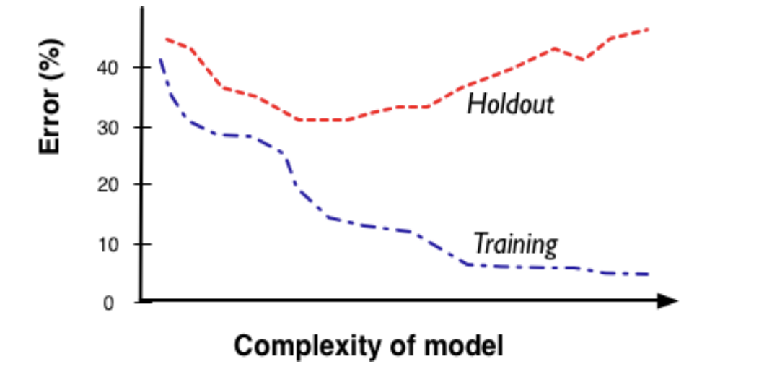
Complexity vs. Error
Overfitting: model is too complex: the model fits great on the training data but doesn’t generalize to holdout data because it is “memorizing” the training data.
This is one of the most important concepts of machine learning
Models always get better (as measured on training set) with more data or more complexity
But need holdout data to optimize generalizability
Notes:
Remember how R^2 always gets better when you add variables!!

Slide 8
Complexity vs. Error
All Models have complexity parameters:
Tree models => number of nodes, min leaf size
Regression models => # features, degree of polynomial, interactions
Neural Nets => layers, complexity of functions
Notes:
Complexity control

Slide 9
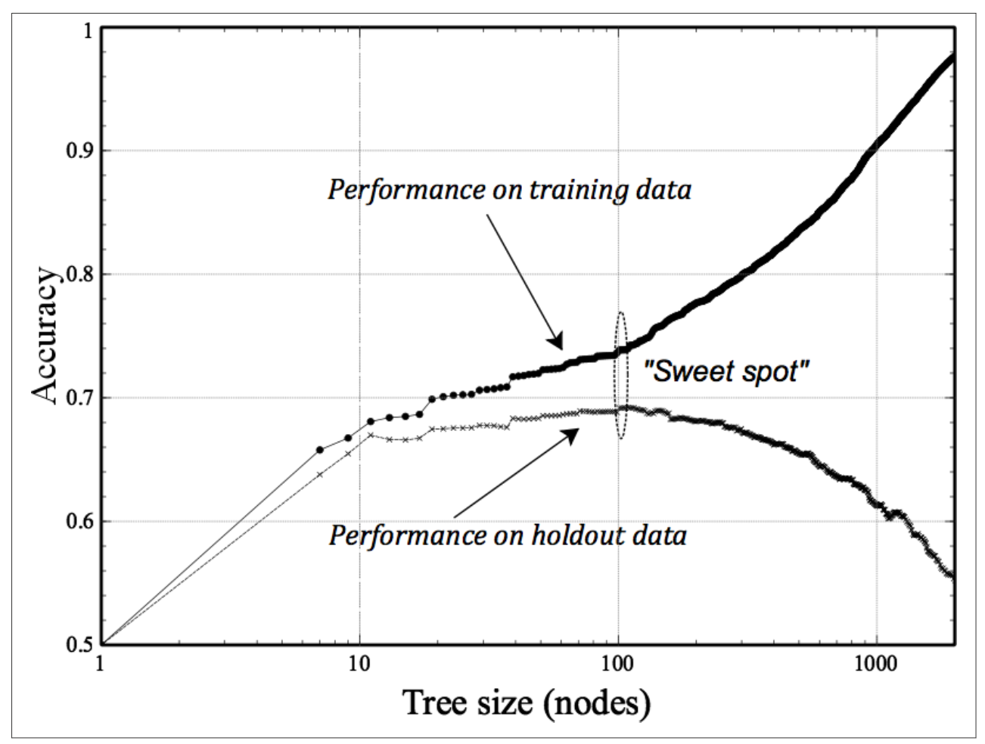
Using Holdout sets for Tree induction
You can use the complexity tradeoff to find the best size for a tree
DSB Fig 5-3
Note we are using Accuracy on y-axis, not error!
Note: log scale on nodes

Slide 10
Cross-validation
We can use fitting graphs like the one we just saw to balance complexity with performance, and estimate the performance.
BUT maybe this performance curve is a function of the specific 80/20 split that we chose!
Think about our tree example, we evaluated all tree sizes on the same holdout set…this could also lead to memorization
To get a better generalization error estimate, account for the randomness of the split …. by doing multiple splits.
Cross-validation is one way to get around this!

Slide 11
Cross-validation
Cross-validation algorithm
Split data into k equal sets, called folds
Fit model with sets (1,…,k-1), measure performance on fold k
Subsequently fit k times using each fold as a hold-out
For each iteration, measure predictive performance, or the metric of interest
from sklearn.model_selection import cross_val_score
cross_val_score(model, X, Y, scoring="accuracy", cv=5)

Slide 12
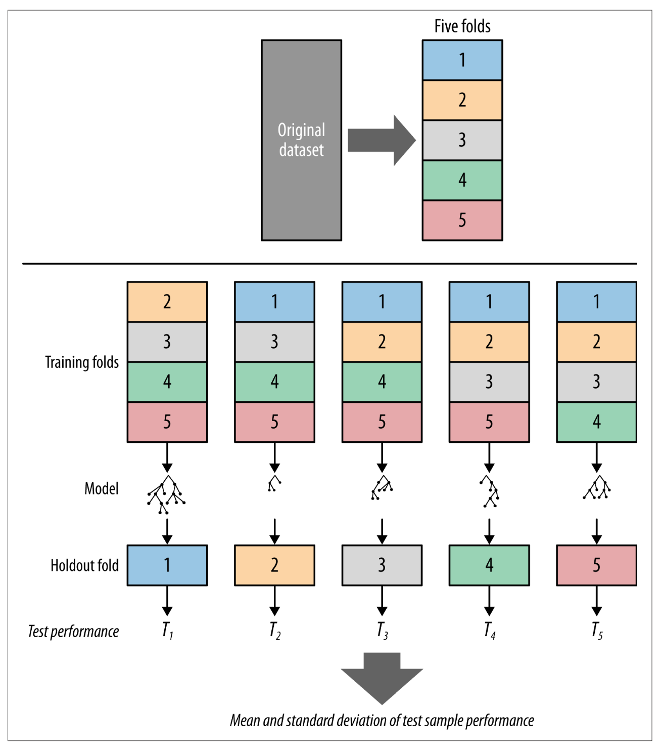

Slide 13
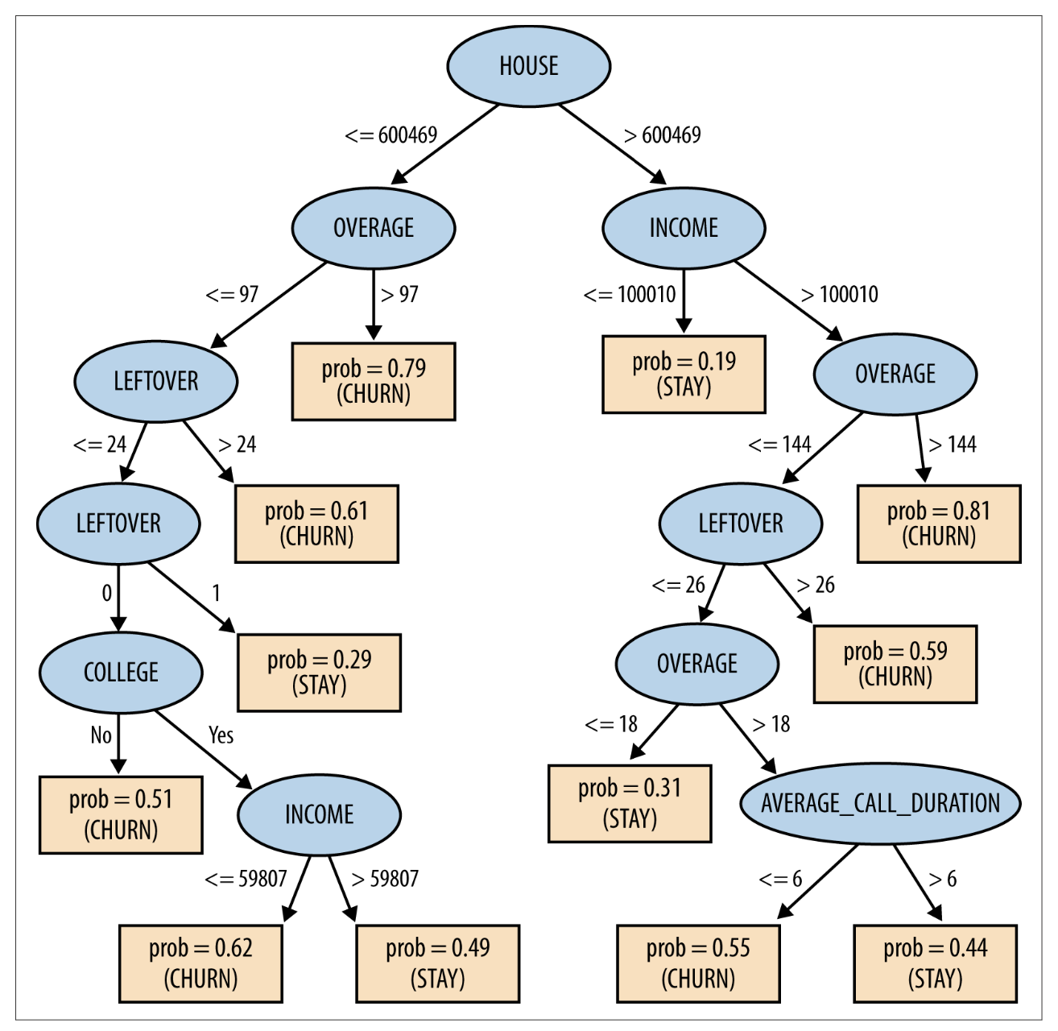
Example : predicting churn
Churn accuracy on training set =73%

Slide 14
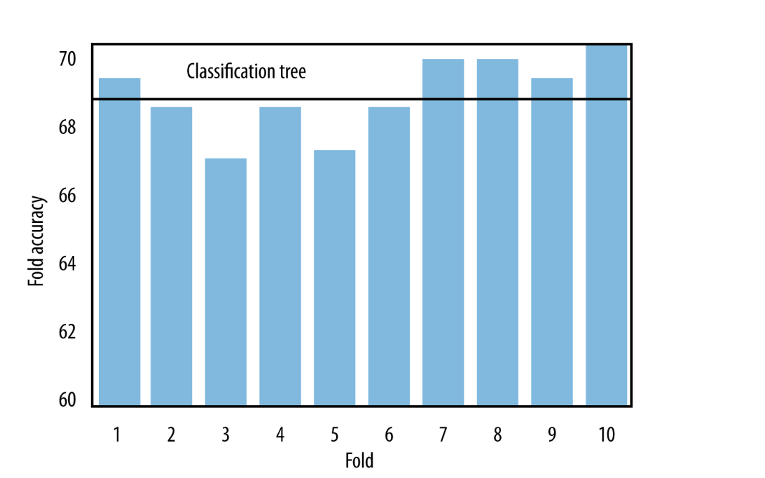
Example : predicting churn
10-fold cross-val:
Averaging accuracy across 10 folds =>
More realistic estimate of the accuracy that will be seen in the real world
Protects against one “bad” hold-out sample
DSB: p140
Notes:
Go back to our example

Slide 15
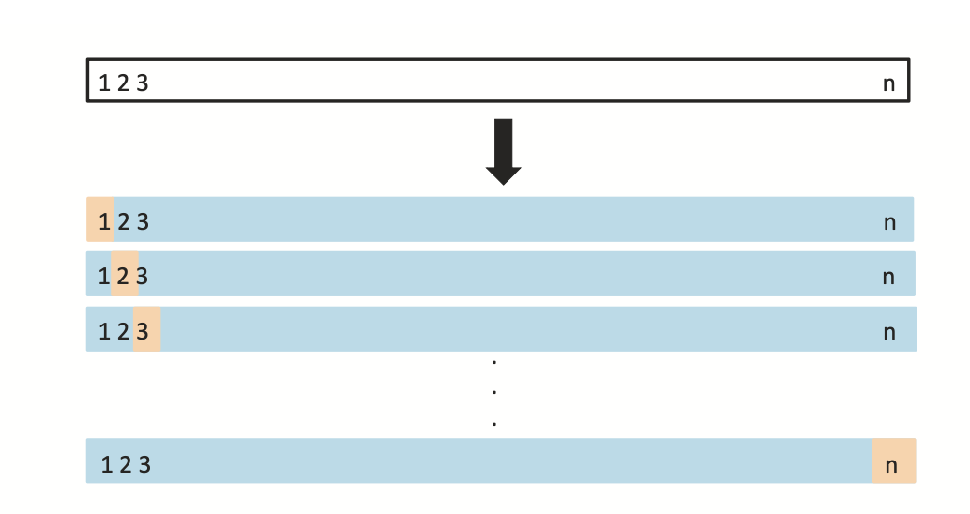
Leave One Out Cross Val (LOOCV)
How many folds???
You can take cross-validation to the extreme:
Fit model on all but one data point
Predict on the single data point and measure error
Do that N times, once for each data point:
LOOCV is the best in terms of estimating true error
BUT – can be very time-consuming
Not necessary for larger data sets
from sklearn.model_selection import LeaveOneOut, cross_val_score
loo=LeaveOneOut()
cross_val_score(model, X, Y, scoring="accuracy", cv=loo)
ISL p 205

Slide 16
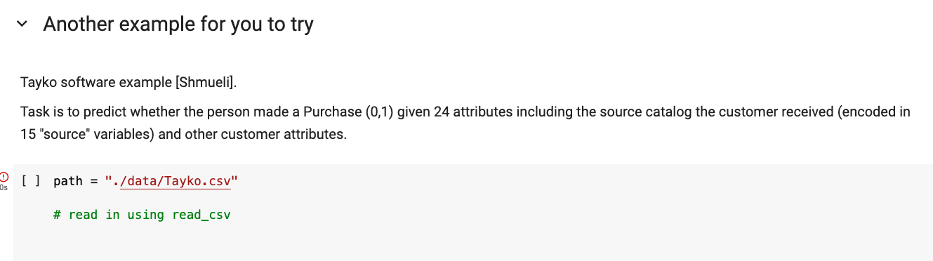
Back to our example

Slide 17
Fitting Curves and Cross-Validation
T5_Fitting_and_overfitting.ipynb

Slide 18
Validation set
The test set serves two purposes : to find the best parameters and to estimate the out-of-sample error – so it is not really an “unbiased” estimate of error
In some cases, it may be useful to create a third partition of the data
Provides a truly untouched data set that gives the most accurate estimates of error
Process:
Put aside a random 10-20%
Split remaining data as normal into training and validation sets
Use Training/validation to set parameters (e.g. optimal tree_depth) and then simply apply to the Holdout data
Training Data
(fit model)
Validation data
(evaluate model,
Optimize params)
Test/Holdout
data
(estimate error)
Notes:
Summarize things here:
Training / test
CV
CVLOO
Validation Setjk

Slide 19
Evaluating Classification Models

Slide 20
Model Performance
Classification models predict what class an instance (example) belongs to.
E.g., good vs. bad credit risk (Credit), Response vs. no response to a direct marketing campaign, etc.
Evaluation measure: Classification Accuracy
Model assigns Probability
Probability => Class Label
Default cutoff for (+/-) is 50%
What are the possible problems with this?
Notes:
What if the overall “truth” is not 50%?
What if the cost of something is much higher? You are willing to accept a much smaller probability.
What if I can only take action on a smaller percent (budget for a task)?

Slide 21
Probability to Classification
Consider our Churn example, and using a tree model to predict churn
Inputs |  |  |  | Target | Model’s Prediction | Predicted Class ?
Contract | CareCalls | Age | Income | churn | P(churn) | churn
0 | 1 | 28 | 39K | 1 | 0.81
1 | 2 | 56 | 183K | 0 | 0.31
0 | 5 | 61 | 63K | 0 | 0.72
0 | 1 | 28 | 20K | 1 | 0.54
1 | 2 | 33 | 50k | 0 | 0.51
… | … | … | … | … | …

Slide 22
Probability to Classification:
Use standard cutoff at 0.5
If p(churn) > 0.5 then predict churn = 1
Inputs |  |  |  | Target | Model’s Prediction | Predicted Class
Contract | CareCalls | Age | Income | churn | P(churn) | churn
0 | 1 | 28 | 39K | 1 | 0.81 | 1
1 | 2 | 56 | 183K | 0 | 0.31 | 0
0 | 5 | 61 | 63K | 0 | 0.72 | 1
0 | 1 | 28 | 20K | 1 | 0.54 | 1
1 | 2 | 33 | 50k | 0 | 0.51 | 1
… | … | … | … | … | …

Slide 23
Probability to Classification:
Use standard cutoff at 0.5
Inputs |  |  |  | Target | Model’s Prediction | Predicted Class | Correct/ incorrect
Contract | CareCalls | Age | Income | churn | P(churn) | churn
0 | 1 | 28 | 39K | 1 | 0.81 | 1 | √
1 | 2 | 56 | 183K | 0 | 0.31 | 0 | √
0 | 5 | 61 | 63K | 0 | 0.72 | 1 | X
0 | 1 | 28 | 20K | 1 | 0.54 | 1 | √
1 | 2 | 33 | 50k | 0 | 0.51 | 1 | X
… | … | … | … | … | … | …

Slide 24
Probability to Classification:
What cutoff correlates best to the action we would take….
Try another cutoff = 0.8
Inputs |  |  |  | Target | Model’s Prediction | Predicted Class | Correct/ incorrect
Contract | CareCalls | Age | Income | churn | P(churn) | churn
0 | 1 | 28 | 39K | 1 | 0.81 | 1 | √
1 | 2 | 56 | 183K | 0 | 0.31 | 0 | √
0 | 5 | 61 | 63K | 0 | 0.72 | 0 | √
0 | 1 | 28 | 20K | 1 | 0.54 | 0 | X
1 | 2 | 33 | 50k | 0 | 0.51 | 0 | √
… | … | … | … | … | … | … | …
Notes:
Don’t expect 50% churn
Cant act on it anyway
Maybe acting is expensive

Slide 25
What cutoff to choose?
Depends on:
- the baserate
- what action we intend to take
- the cost of the action we intent to take
- the distribution of the predictions
We may want to explore multiple cutoffs

Slide 26
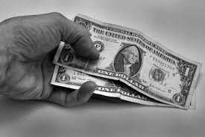
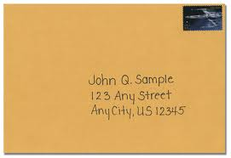
Example: Non-profit Mailing
You work for a non-profit with a big mailing list
You want to send a high-quality physical mail with a solicitation to give to the charity
You build a model to predict who is likely to respond to the mailing based on previous donations, demographics, and other features.
Notes:
Question: What factors might go into determining who you send the mail to?
AKA – where do you set the threshold
Depends on cost, budget
Probability of success
Cost of type 1 and type 2 error
Lead them to..what are the errors….

Slide 27
Practical Example: Non-profit Mailing
P(+)
0.185
0.159
0.131
0.115
0.108
0.068
0.066
0.03
0.025
0.023
0.023
0.016
0.009
0.005
0.001
Fit a model for response to the marketing campaign, what is the probability of donating. The model comes back with these probabilities (sorted):
What questions would you ask in order to figure out how to set the threshold?
Notes:
What is the cost of the mailing?
What is the expected take rate?
How much do we expect to make
What is your budget?

Slide 28
Example: Non-profit Mailing
Assumptions
Cost: $1 for each letter
Fixed amount of response
If response: $10 donation
No response: $0 donation

Slide 29
Non-profit mailing
100K addresses
Cost: $1 for each letter
Benefit:
If response: $10
No response: $0
P(+)
0.185
0.159
0.131
0.115
0.108
0.068
0.066
0.03
0.025
0.023
0.023
0.016
0.009
0.005
0.001
Prediction to Action?
Sort
Pick all examples with p(response)>0.1
Cutoff = 0.1!
We will formalize this…

Slide 30
False Positives and False Negatives
For a classification model, the cutoff used has an impact on the overall error
False positives and false negatives
False positive (FP): we predict “positive” when it is not true
False negative (FN): we fail to predict “positive” when we should have
Similar to Type 1 or Type 2 errors in statistics
In classification problems, you must consider the costs and implications of a FP or FN..
Non-profit mailing list Example?
MegaTelCo Churn Example?
Target Example?
Medical test example?
Notes:
Other examples: pharma / drugs
Disease detection..maybe false positive isn’t so bad, because you can just send for a different test
new software - amazon - engaging more customers / more revenue

Slide 31
Confusion Matrix
A Confusion matrix is a way of presenting the FN and FP rates for a given prediction
 | Truth=1 | Truth = 0
Predicted = 1 | True Positives (TP) | False Positives (FP) | Total Predicted +
Predicted = 0 | False Negatives (FN) | True Negatives (TN) | Total Predicted -
 | Total True + | Total True - | Total n
Notes:
What is the accuracy???

Slide 32
Determining the cutoff
Truth | Model Prediction
1 | 0.901
0 | 0.868
1 | 0.725
1 | 0.701
0 | 0.605
1 | 0.502
0 | 0.475
0 | 0.470
0 | 0.466
1 | 0.435
1 | 0.430
0 | 0.327
0 | 0.315
1 | 0.309
0 | 0.281
0 | 0.268
0 | 0.227
0 | 0.190
0 | 0.100
0 | 0.158
For a classification model, the cutoff used determines the FP and FN rate (calculated on a holdout set)
Here is a list of model predictions of churn (from a holdout set) with the true values unveiled (n=20)
What are the FP and FN totals for a cutoff of 0.5?
Notes:
FP = 2/6
FN = 3/14

Slide 33
Building a Confusion Matrix
Truth | Model Prediction
1 | 0.901
0 | 0.868
1 | 0.725
1 | 0.701
0 | 0.605
1 | 0.502
0 | 0.475
0 | 0.470
0 | 0.466
1 | 0.435
1 | 0.430
0 | 0.327
0 | 0.315
1 | 0.309
0 | 0.281
0 | 0.268
0 | 0.227
0 | 0.190
0 | 0.100
0 | 0.158
Cutoff = 0.5
 | Truth=1 | Truth = 0
Predicted = 1 | 4 | 2 | 6
Predicted = 0 | 3 | 11 | 14
 | 7 | 13 | 20
What is the Accuracy?
Accuracy = (TP + TN) / n = 15/20 = .75
Notes:
FP = 2/6
FN = 3/14

Slide 34
Confusion matrix with different cutoffs
Truth | Model 1 | Cut 0.3 | Cut 0.5 | Cut 0.7
1 | 0.901 | 1 | 1 | 1
0 | 0.868 | 1 | 1 | 1
1 | 0.725 | 1 | 1 | 1
1 | 0.701 | 1 | 1 | 1
0 | 0.605 | 1 | 1 | 0
1 | 0.502 | 1 | 1 | 0
0 | 0.475 | 1 | 0 | 0
0 | 0.470 | 1 | 0 | 0
0 | 0.466 | 1 | 0 | 0
1 | 0.435 | 1 | 0 | 0
1 | 0.430 | 1 | 0 | 0
0 | 0.327 | 1 | 0 | 0
0 | 0.315 | 1 | 0 | 0
1 | 0.309 | 1 | 0 | 0
0 | 0.281 | 0 | 0 | 0
0 | 0.268 | 0 | 0 | 0
0 | 0.227 | 0 | 0 | 0
0 | 0.190 | 0 | 0 | 0
0 | 0.100 | 0 | 0 | 0
0 | 0.158 | 0 | 0 | 0
Model predictions
Cut=0.7 | Truth=1 | Truth=0
Pred=1 | 3 | 1
Pred=0 | 4 | 12
Cut = 0.5 | Truth=1 | Truth=0
Pred=1 | 4 | 2
Pred=0 | 3 | 11
Cut = 0.3 | Truth=1 | Truth0
Pred=1 | 7 | 7
Pred=0 | 0 | 6
Every cutoff generates classifier with a different confusion matrix
Which is best?

Slide 35
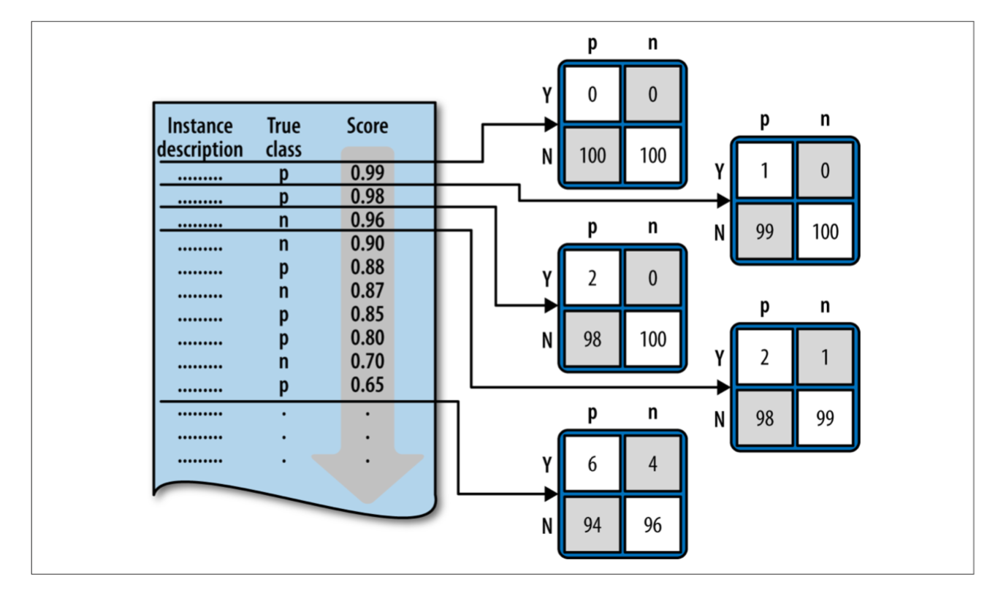
From DSB
Notes:
Every single point (when sorted) generates a new confusion matrix…

Slide 36
Confusion Matrix example
 | Truth=1 | Truth=0 | Total
Pred=1 (+) | 4 (TP) | 2 (FP) | 6 (Pred+)
Pred=0 (-) | 3 (FN) | 11 (TN) | 14 (Pred-)
Total | 7 (Base+) | 13 (Base-) | 20 (N)
TP=True Positives: 4
FP=False Positives: 2
FN=False Negatives: 3
TN = True Negatives: 11
Pred+ = Predicted positives: 6
Pred- = Predicted negatives: 14
Baserate of positives (Base+/N): 7/20 = 35%
Baserate of negatives (Base-/N): 65%
P\A | Truth=1 | Truth=0
Pred=1 (+) | TP | FP | Pred+
Pred=0 (-) | FN | TN | Pred-
 | Base+ | Base- | N

Slide 37
Classifier Evaluation Metrics
P\A | Truth=1 | Truth=0
Pred=1 (+) | TP | FP | Pred+
Pred=0 (-) | FN | TN | Pred-
 | Base+ | Base- | N
Accuracy: (TP + TN)/N
Error rate: (FP + FN)/N
Precision: TP/Pred+
Exactness: Out of those we labelled positive - what % are we correct?
Recall: TP/Base+
Completeness – Out of those that are TRULY positive - what % are we correct?
All of these change with the the cutoff!
Notes:
we quantify the balance of FP and FN via precision and recall

Slide 38
Precision and Recall??
Truth | Model 1 | Cut 0.3 | Cut 0.5 | Cut 0.7
1 | 0.901 | 1 | 1 | 1
0 | 0.868 | 1 | 1 | 1
1 | 0.725 | 1 | 1 | 1
1 | 0.701 | 1 | 1 | 1
0 | 0.605 | 1 | 1 | 0
1 | 0.502 | 1 | 1 | 0
0 | 0.475 | 1 | 0 | 0
0 | 0.470 | 1 | 0 | 0
0 | 0.466 | 1 | 0 | 0
1 | 0.435 | 1 | 0 | 0
1 | 0.430 | 1 | 0 | 0
0 | 0.327 | 1 | 0 | 0
0 | 0.315 | 1 | 0 | 0
1 | 0.309 | 1 | 0 | 0
0 | 0.281 | 0 | 0 | 0
0 | 0.268 | 0 | 0 | 0
0 | 0.227 | 0 | 0 | 0
0 | 0.190 | 0 | 0 | 0
0 | 0.100 | 0 | 0 | 0
0 | 0.158 | 0 | 0 | 0
Model predictions
Cut=0.7 | Truth=1 | Truth=0
Pred=1 | 3 | 1
Pred=0 | 4 | 12
Cut = 0.5 | Truth=1 | Truth=0
Pred=1 | 4 | 2
Pred=0 | 3 | 11
Cut = 0.3 | Truth=1 | Truth0
Pred=1 | 7 | 7
Pred=0 | 0 | 6
Notes:
What are the tradeoffs here?
Calculate precision and recall for each of these cases
75/ 43 f=55
66/ 57 f=61
50/ 100 f=67

Slide 39
Example
 | Truth=1 | Truth=0 | Total
Pred=1 | 90 | 140 | 230
Pred=0 | 210 | 9560 | 9770
Total | 300 | 9700 | 10000
Accuracy =
Error Rate=
Precision =
Recall =
P\A | Truth=1 | Truth=0
Pred=1 (+) | TP | FP | Pred+
Pred=0 (-) | FN | TN | Pred-
 | Base+ | Base- | N
39
Notes:
accuracy = 96.5%
error = 3.5%
precision = 39%
recall = 30%
F=33.9

Slide 40
Evaluation Curves and Metrics

Slide 41
Evaluation Curves and Metrics
We have seen that the performance of a classification model depends on what the cutoff probability is
How do we define the overall performance of a model?
Three curves
There are actually many more options, but these three are the most used and useful
Precision-Recall Curves
ROC curves
Lift Curves

Slide 42
Baserate as Baseline
Truth | Model Prediction
1 | 0.901
0 | 0.868
1 | 0.725
1 | 0.701
0 | 0.605
1 | 0.502
0 | 0.475
0 | 0.470
0 | 0.466
1 | 0.435
1 | 0.430
0 | 0.327
0 | 0.315
1 | 0.309
0 | 0.281
0 | 0.268
0 | 0.227
0 | 0.190
0 | 0.100
0 | 0.158
‘baserate’ is the overall prevalalnce of positive cases
Example on the right
baserate of success (Truth=1) = 35%
baserate of failure = 65%
Typically use “1” or “+” for the minority class
A dumb model can always have accuracy at least as high as the baserate of success (or failure)
‘balanced’ refers to how close the baserate is to 50%

Slide 43
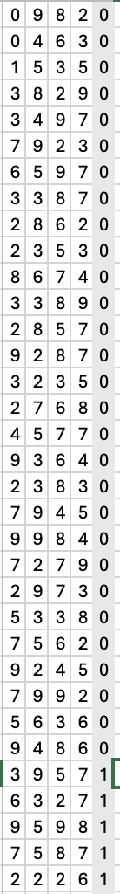
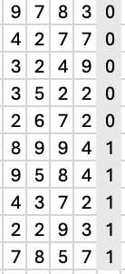
Problems with Unbalanced Classes
features
fraud
Many use cases are highly unbalanced - (e.g. fraud, where 0.1% or less are fraud cases)
Models can ignore the minority class – challenge to get good recall
Can perform poorly identifying minority class (often of most interest)
Two solutions:
Sample from the majority class
Goal: 50/50 data points
Use class_weight=‘balanced’
Upweight minority cases
Random sample
99.9%
not fraud
Balanced
Data
0.1 %
fraud
Notes:
Models might end up predicting almost all cases as positive

Slide 44
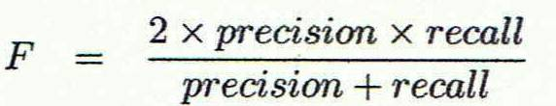
1) Precision/Recall Tradeoff:
High Precision:
Use a high cutoff.
Want to be really sure that those predicted true are really true!
Use when the cost of a false positive is high
Example: Medical tests?
High Recall
Use lower cutoff
When you want to be sure to get as many positive cases as possible
Use when the cost of a false positive is not so high
Example: advertising? Fraud?
If you want the best of both worlds, you can use the F-measure
Notes:
harmonic mean
= .35 for example on last slide

Slide 45
Precision recall curve
Recall that Precision and Recall change with each value of the cutoff

Slide 46
Precision recall curve
from sklearn.metrics import PrecisionRecallDisplay
Plot precision vs recall for each possible cutoff
Precision = 1 when recall is close to 0, and vice versa.
When Recall = 1, Precision = baserate
Truth | Model Prediction
1 | 0.901
0 | 0.868
1 | 0.725
1 | 0.701
0 | 0.605
1 | 0.502
0 | 0.475
0 | 0.470
0 | 0.466
1 | 0.435
1 | 0.430
0 | 0.327
0 | 0.315
1 | 0.309
0 | 0.281
0 | 0.268
0 | 0.227
0 | 0.190
0 | 0.100
0 | 0.158
Notes:
Allows you to visualize the balance between precisison and recall and make a decsions…

Slide 47
However..
Precision and recall are useful metrics to compare two different models
i.e. two models with the same precision may have different recalls, the one with more recall is better (F-value)
But, precision is not always useful
Remember the example: imagine a model that is predicting whether someone clicks on an ad
99.9% of people do not click on the ad
Model can easily get 99.9% precision!
What would the recall be in this scenario

Slide 48
Ranking Models
One thing to notice – the P/R curve doesn’t contain the actual cutoffs, it is determined by the ranking of the test data cases
In fact, for some data science tasks, all that matters is that we rank the test cases, the actual probabilities don’t matter
Helpful because probabilities are hard to validate!
Can you think of an example?
Notes:
e.g. if we have a budget and can only send a certain number of cases…

Slide 49
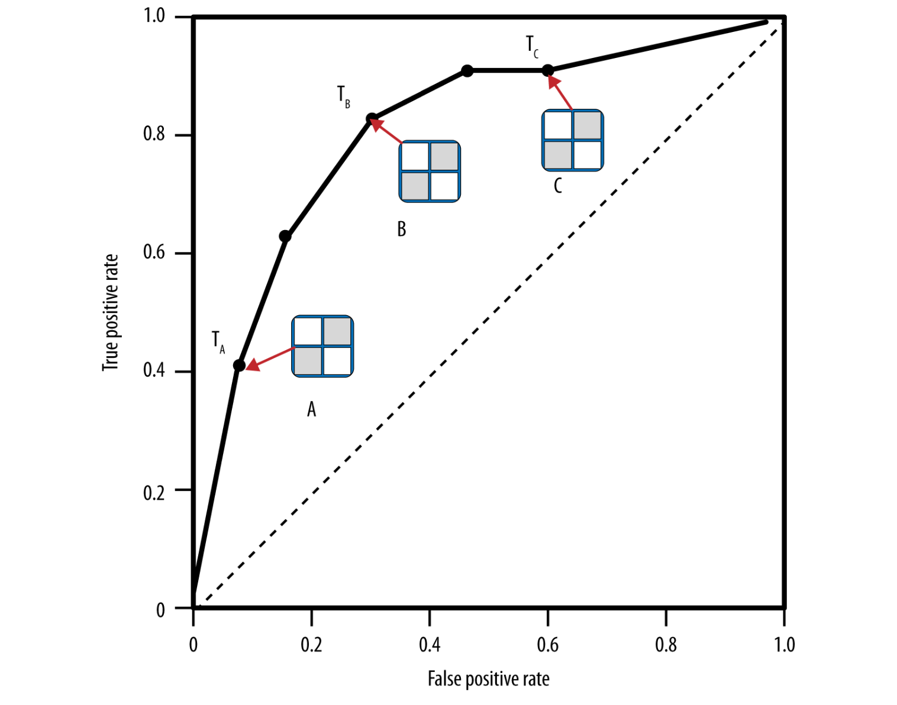
2) ROC Curve
ROC = receiver operating characteristic (yuck)
ROC curves trade off
Benefit (true positive rate)
Cost (false positive rate)
Each point in the ROC space corresponds to a different cutoff
Y = True Positive Rate = TP/Base+
Recall, or “hit rate”
X = False Pos Rate = FP/Base-
“false alarm rate”
Always goes from (0,0) to (1,1)
P\A | Truth=1 | Truth=0
Pred=1 (+) | TP | FP | Pred+
Pred=0 (-) | FN | TN | Pred-
 | Base+ | Base- | N
What if a model is no better than random guessing?
Notes:
random = I have as many true positives as false positives..

Slide 50
ROC Curve
Perfect Model
(1,0)
1.0
0.9
”Good” models are further from random line
0.8
Everything predicted +
(1,1)
true positive rate (TP)
A
Line represents null or random model
0.2
0.1
0
Nothing is predicted +
(0,0)
0
0.1
0.2
false positive rate (FP)
0.8
0.9
1.0
decreasing cutoff

Slide 51
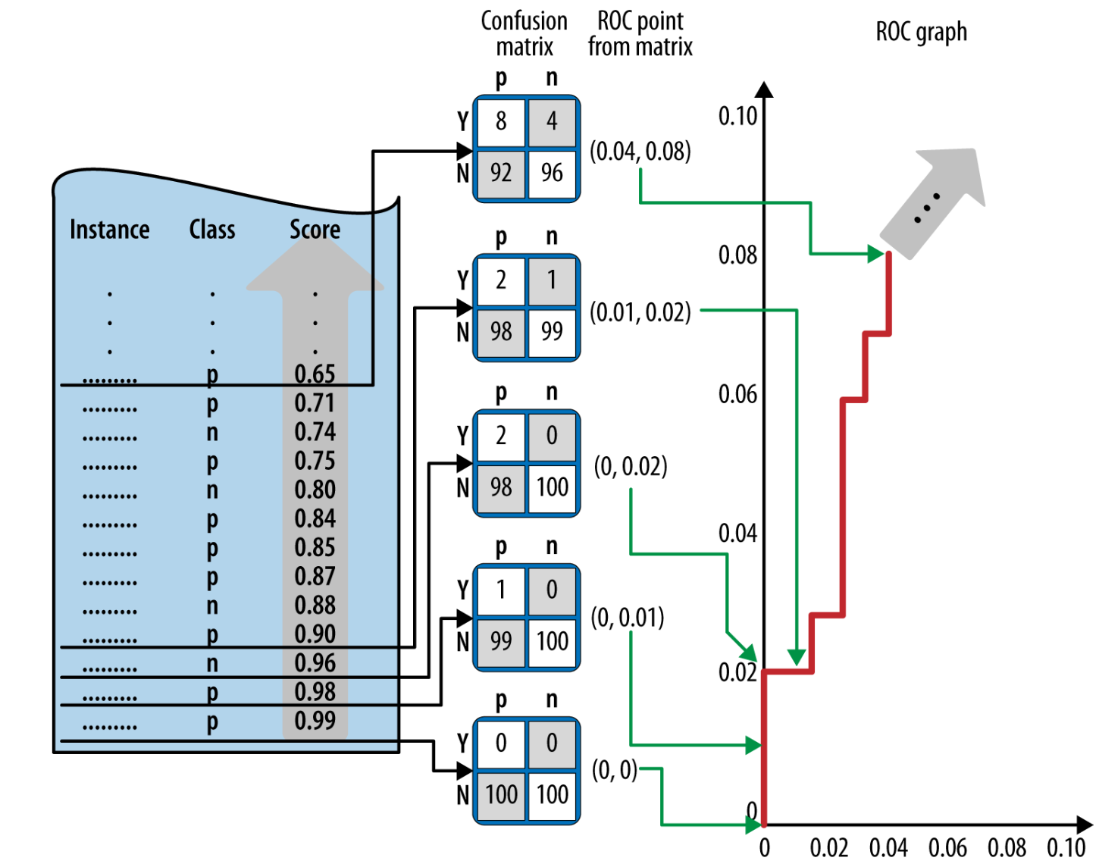
Example from DSB
PF p 218

Slide 52
Why ROC?
Has some nice qualities
The underlying probabilities are not relevant
Only measures the quality of the ranking
Not impacted by the baserate
All curves go from (0,0) to (1,1)
Allows comparisons of different models, even different data sets
Provides a single metric of performance for a given model, regardless of baserate …

Slide 53
AUC
from sklearn.metrics import roc_auc_score
AUC = Area under the ROC curve
Literally - just the calculated area under the ROC curve
Has become a standard metric for machine learning models due to some nice properties
Measures the overall ranking quality of the model
Bounded between 0 and 1
Interpretation: probability that model will rank a positive case higher than a negative case
Independent of baserate
0.5 means no better than random model

Slide 54
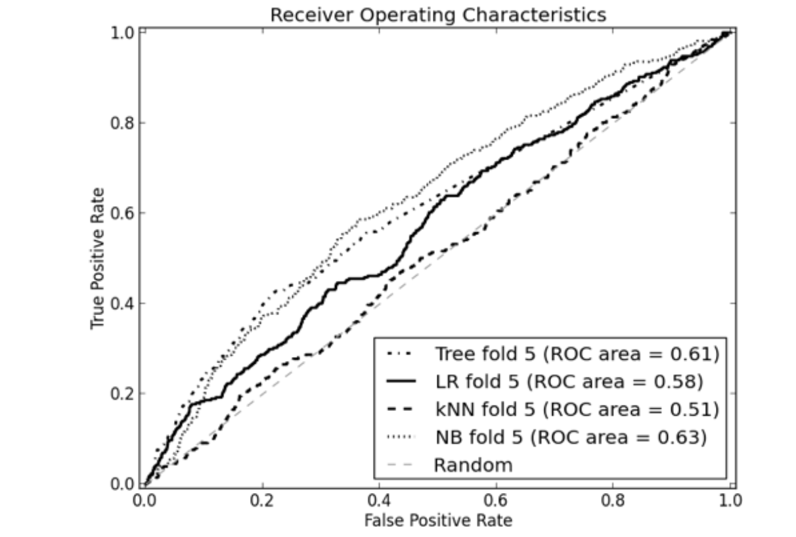
AUC examples
Easy to compare models, to baseline and to each other
More “northwest” a model is the better it is
Higher AUC is better
DSB p 227

Slide 55
3) Lift Curve
ROC curves are good for showing across the entire dataset how well you compare to a “random” model
Sometimes that is the most important thing!
Example: Churn
Say I can only offer a retention deal to a maximum of 3% of my customers. How much better is my model than blind selection of 3%?
How many of my churners do I expect to find if I randomly select 3% of customers?
If my model is good, how many of my churners do I expect to capture in the top 3% of my churn score?
Notes:
ROC sets thresholds for entire data set, but maybe I KNOW I am not going to set the threshold at 50% so why bother?

Slide 56
Lift Curve
Lift curves directly address this question
Very similar to ROC curves.
Lift: improvement obtained over randomness (aka, the value of the model)
To calculate the lift, we introduce *yet another* curve, the cumulative response curve…(also called cumulative gains)
Cumulative Response plots :
- True Positive Rate on y-axis (same as ROC)
Vs.
- Percentage of population targeted (simply – number of observations, does not depend on the model)
Notes:
Slacker Steve..Im just going to take a random 3%?

Slide 57
Cumulative response curves
100
C
90
80
B
TP/Base+
D
Lift for Model A at 50% = the improvement over the random model: i.e. 65%/50% = 1.3
true positive (TP)
A
20
Lift for Model A at 10% = the improvement over the random model: i.e. 40%/10% = 4.0
Lift for Model A at 1% = the improvement over the random model: i.e. 9%/10% = 9.0
10
0
100
0
10
20
% targeted
80
90
decreasing cutoff
Pred+/N

Slide 58
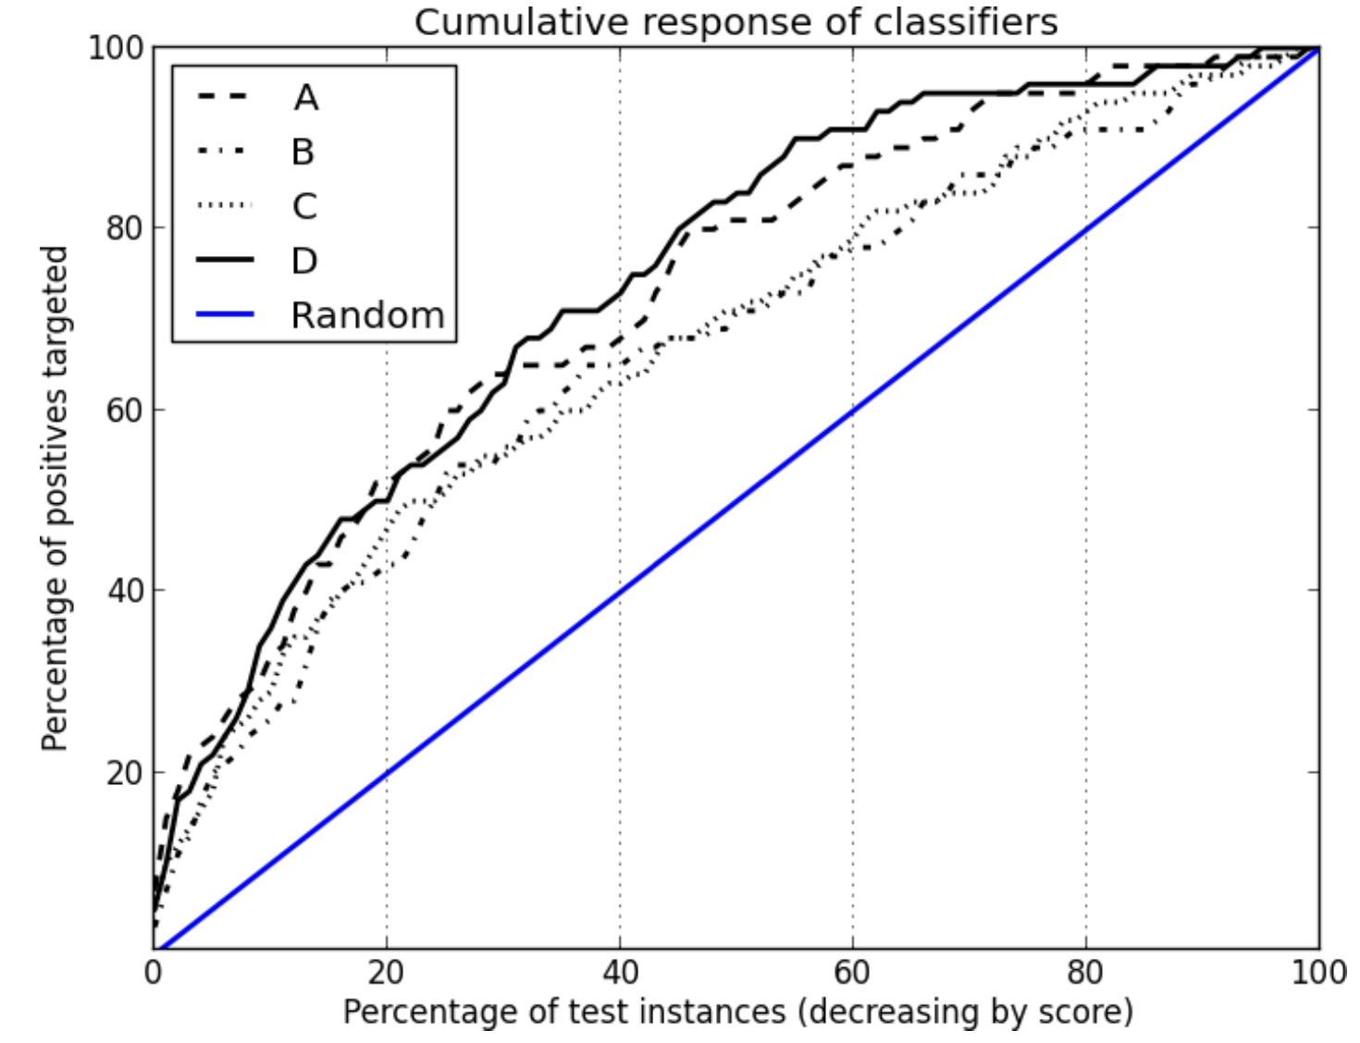
Cumulative response curves => Lift
recall
Lift for Model A at 50% = the improvement over the random model: i.e. 80%/50% = 1.6
Lift for Model A at 10% = the improvement over the random model: i.e. 37%/10% = 3.7
Lift for Model A at 1% = the improvement over the random model: i.e. 7.5%/1% = 7.5
Pred+ / N
Notes:
this curve allows you to test your 80/20 rule

Slide 59
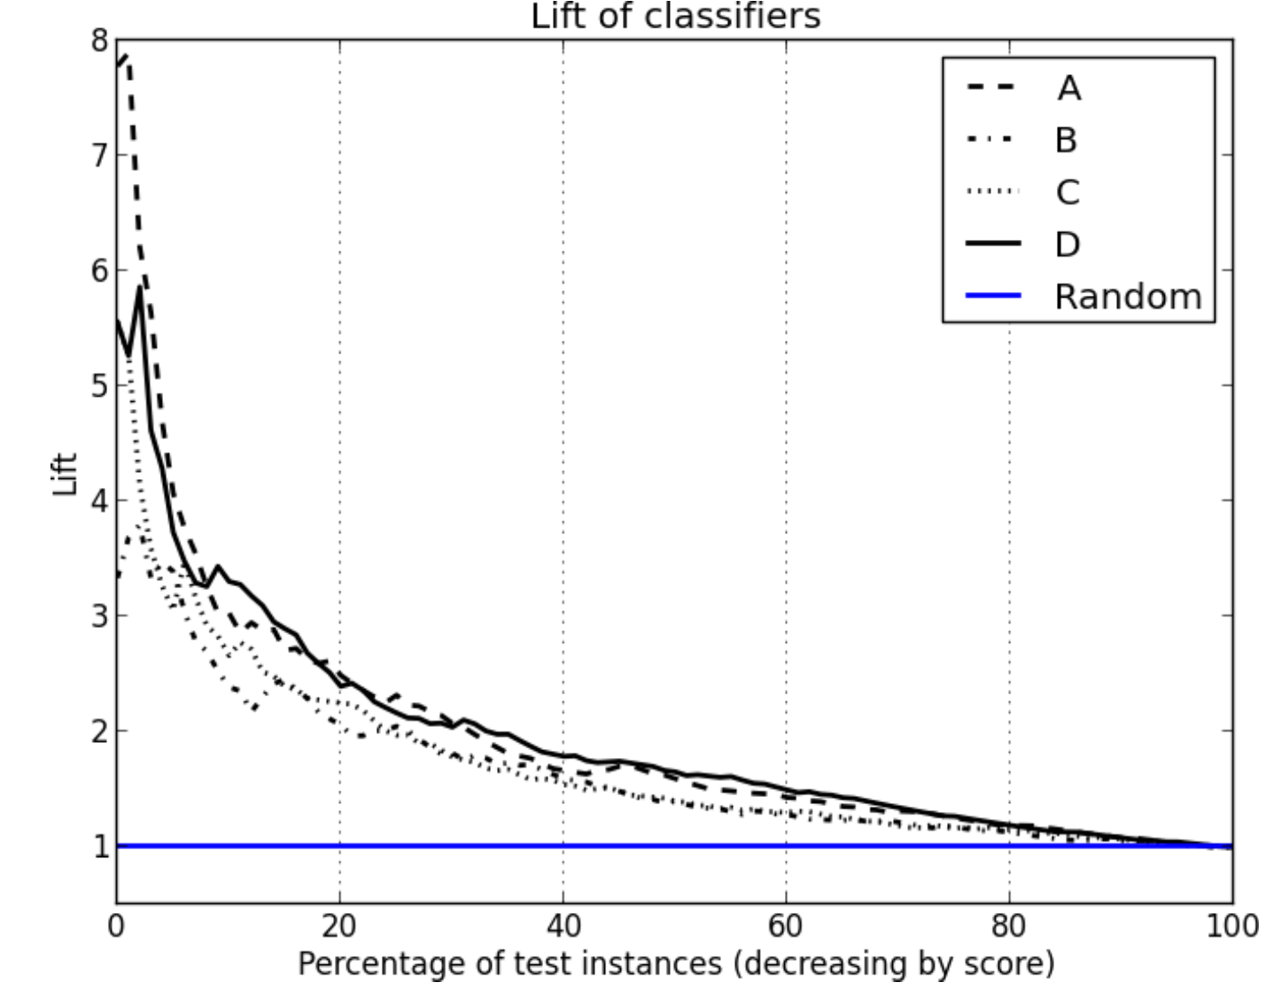
From Cumulative Response to Lift
Lift Curve plots the lift from the Cumulative Response Curve in order to highlight the improvement over the random model – particularly at the points of highest precision
Notes:
sometimes we just remove the left hand side of the plot.
might also see this as a decile plot

Slide 60

So Many Curves!
We have learned about:
Precision-Recall Curves
ROC curves
Lift Curves (via Cumulative Response)
What to use?!?!?!
ROC Curves (and particularly AUC) are a standard way to give overall performance of a model and compare between models.
P/R curves: Allow you to clearly see the balance between precision and recall. BUT they depend on the baserate and so not comparable between data sets.
Lift curves are used when “overall” accuracy is less important and you really care about how well you can ”slice off” the most likely cases.
Can be field-specific. (Marketing => Lift curves)
As always, it depends on the business problem, the audience, and the need for interpretability!!
Notes:
Don’t care about performance outside of the top 1% or 10%

Slide 61
Evaluation using Expected Value

Slide 62
Using Expected Value for Evaluation
Earlier when we talked about confusion matrices, we discussed how different errors (False Positive or False Negative) might have different costs based on the problem
Similarly, the benefit of getting the right classification might have different benefits
The Expected Value Framework is a way to incorporate these directly into the evaluation – and also help to set the cutoffs
 | Truth=1 | Truth = 0
Predicted = 1 | True Positives (TP) | False Positives (FP) | Total Predicted +
Predicted = 0 | False Negatives (FN) | True Negatives (TN) | Total Predicted -
 | Total True + | Total True - | Total n

Slide 63
Cost/Benefit Matrix
Think about the non-profit marketing example:
Imagine it costs $1 to send a solicitation and assume that if someone donates they donate on average $10. Then what is the net cost/benefit matrix?
B=Benefit (can be negative if there is a cost)
 | Response= + | Response = -
Solicitation = Y | B(Y,+) = 9 | B(Y,-) = -1
Solicitation = N | B(N,) = 0 | B(N,-) = 0
The Expected Value of money you make if you send the solicitation depends on the probability of them responding
EV(solicitation = Y) = P(+|Y) x B(Y,+) + p(-|Y) x B(Y, -)
Comes from model

Slide 64
Cost/Benefit Matrix
 | Response= + | Response = -
Solicitation = Y | B(Y,+) = 9 | B(Y,-) = -1
Solicitation = N | B(N,-) = 0 | B(N,-) = 0
B=benefit
The Expected Value of money you make if you send the solicitation depends on the probability of them responding
EV(solicitation = Y) = P(+|Y) x B(Y,+) + p(-|Y) x B(Y, -)
Let p = the probability that they respond (from model)
EV = p x 9 + (1-p) x (-1)
EV > 0 if p> 0.1, so you would act if the probability is > 0.1
EV(solicitation = N) = P(+|N) x B(N,+) + p(-|N) x B(N, -) = 0
Notes:
This is very flexible…maybe you assume there is a cost if you don’t send it, or maybe you assume they might reply even if you don’t send it…
0 = 9p + (p-1)
10p=1
P = 1/10

Slide 65
Cost/Benefit => Profit
If you make some assumptions about the costs and benefits of your actions, you can use profit as a way to evaluate your models, and set cutoffs.
More generally, the profit of a given model is a combination of the cost/benefit matrix and the confusion matrix.
P\A | Truth=1 | Truth=0
Pred=1 (+) | TP | FP
Pred=0 (-) | FN | TN
P\A | Truth=1 | Truth=0
Pred=1 (+) | B(TP) | B(FP)
Pred=0 (-) | B(FN) | B(TN)
x
Profit = TP/n x B(TP) +
FP/n x B(FP) +
FN/n x B(FN) +
TN/n x B(TN)
Notes:
Do the example here with 10k !!! (p39)
90 140
210 9560
90 x 9 – 1 x 140 = 810 – 140 = $670
9 x .009 + -1 x .014 = 0.067 – this is the profit per customer at that cutoff OR 0.067 x 10000 = $670

Slide 66
DSB p.212
Can plug in every different threshold, and estimate profit

Slide 67

Case Study
Modems in Broadband service
AT&T has a broadband service with tens of millions of customers
We would regularly get calls from customers with router problems.
BUT many problems are fixed with a simple router reboot
We can do router reboots remotely!
The customer care cost of a call + fix is $10 per call
The network cost to implement the fix remotely is $1
We could build a model – based on network diagnostics - to predict if a customer had a problem that was fixable via remote reboot
Dall-E: “image of customer calling customer care with a network problem”
Notes:
The model is predicting whether the customer would be calling in to our service center in the next month.
we are not making any money here! we are just trying to spend the least - all negative...
-1 -1
-10 0

Slide 68

Case Study
Modems in Broadband service:
Build a model and sort by probability to have a problem (likely to call our service center)
Need to choose a threshold above which we will remotely reboot the router.
The threshold we choose will determine how many routers we remotely reboot.
What does the cost/benefit matrix look like?
Calculate for the following three cutoffs:
What is precision/recall
What is the F-measure?
What is the profit?
Dall-E: “can you make the image more realistic and less cartoony?”
TP/FP given in %s
Cut #1 | Truth=1 | Truth=0
Pred=1 | 2 | 3
Pred=0 | 8 | 87
Truth | Model Prediction
1 | 0.901
0 | 0.868
1 | 0.725
1 | 0.701
0 | 0.605
1 | 0.502
0 | 0.475
… | …
… | …
… | ..
Cut #2 | Truth=1 | Truth=0
Pred=1 | 5 | 20
Pred=0 | 5 | 70
Cut #3 | Truth=1 | Truth=0
Pred=1 | 8 | 60
Pred=0 | 2 | 30
Notes:
2/5 = .4
2/10 = .2
.27
5/25 = .2
5/10 = .5
.28
8/68 .11
8/10 .8
.19
Profit: -85, -75, -88

Slide 69
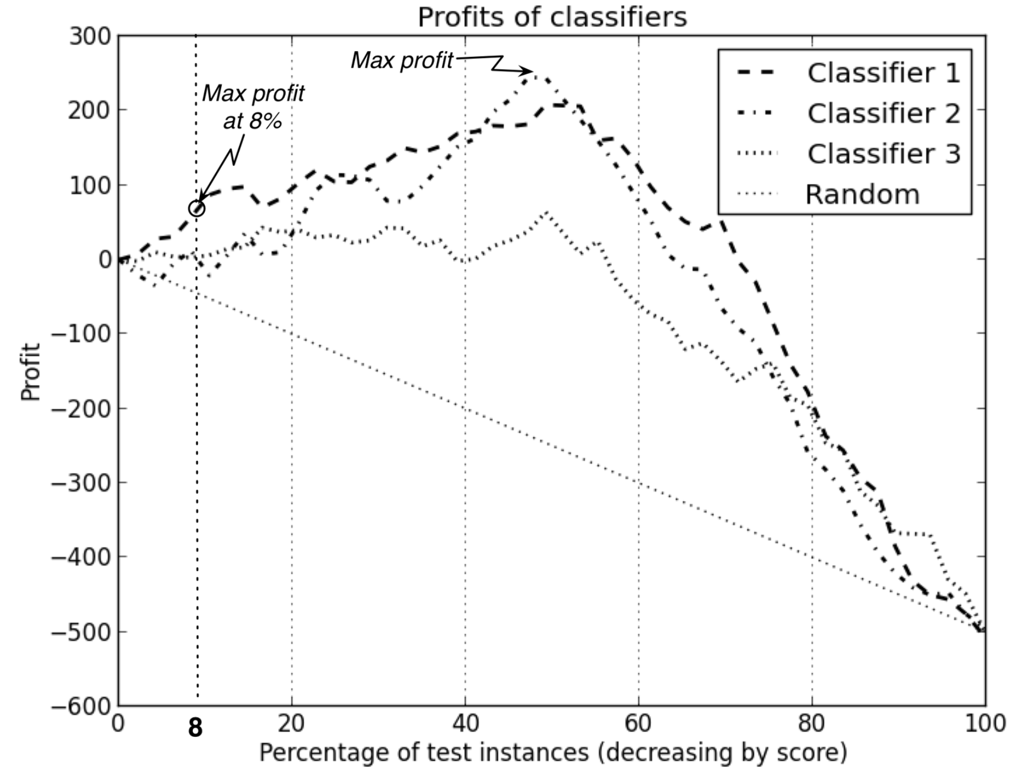
Profit Curves
This brings us to YAC (yet another curve) – calculate the profit for every threshold and select the maximum.
How this is done is very problem specific and typically requires many (informed) assumptions!
DSB p213
Notes:
Not always easy to quantify profit/benefit

Slide 70
Cost / Benefit Matrix
It can get even more complicated
Charity example: what assumptions are you making with this matrix?
 | Response= + | Response = -
Solicitation = Y | B(Y,+) = 9 | B(Y,-) = -1
Solicitation = N | B(N,) = 0 | B(N,-) = 0
Notes:
First: that the error is zero – be careful, not to double count the error
Also, That everyone has the same donation!

Slide 71
Variable Costs/Benefits
Regression Model: Each person has a different predicted benefit!
You may have variable profit costs per customer.
EV(solicitation = Y) = P(+|Y) x B(Y,+) + p(-|Y) x B(Y, -)
EV(not action) = 0
Take action if EV(Y) > 0 for that customer
Example:
EV=0.068* 73 + (1-0.068) * -1 = 4.032
Decision: Send! (even though probability is low, the potential benefit is high enough
p(+) | predicted $
0.115488 | 10
0.001226 | 5
0.005427 | 2
0.067951 | 12
0.015874 | 75
0.025487 | 25
0.023191 | 30
0.022713 | 15
0.029746 | 5
0.088972 | 25
0.067847 | 73
0.066123 | 59
0.075126 | 2
0.080805 | 14
0.009164 | 10
Notes:
can get even more complicated if we consider variance…

Slide 72
Using Evaluation Curves
T5_Model_assessment.ipynb

